Slide 1

Department of Artificial Intelligence & Machine Learning
AI19643 – FOUNDATIONS OF NATURAL LANGUAGE PROCESSING
221501099 PRASANA KISHOR E
221501516 CHARAN B
Mentor : AKSHAYA V

Slide 2
CONTENTS
PROBLEM STATEMENT
MOTIVATION
OBJECTIVES
ABSTRACT
PROBLEM ANALYSIS
EXISTING SYSTEM
SCOPE AND LIMITATIONS
LITERATURE REVIEW
SUMMARY
PROPOSED SYSTEM AND ITS METHODOLOGY
ARCHITECTURE DIAGRAM
LIST OF MODULES
MODULE DESCRIPTION
OUTPUT AND SCREENSHOTS
COMPARATIVE ANALYSIS
CONCLUSION
REFERENCES

Slide 3
PROBLEM STATEMENT
Language barriers present a major challenge in global communication, education, business, and information access. The goal of this project is to develop a Natural Language Processing (NLP)-based translator that can automatically translate text from one language to another using machine translation techniques. This system aims to provide accurate, fast, and context-aware translations across multiple languages, enabling users to understand and communicate regardless of linguistic differences.

Slide 4
MOTIVATION
In an increasingly globalized world, effective communication across different languages is essential for collaboration, learning, travel, and access to information. However, language differences often act as a barrier, limiting opportunities for people to interact, share knowledge, and engage with diverse cultures. This project is motivated by the need to bridge the language gap using the power of Natural Language Processing (NLP) and machine translation.

Slide 5
OBJECTIVES
Develop a multilingual translation system capable of translating text or speech input between various language pairs using machine translation techniques.
Integrate automatic speech recognition (ASR) to allow users to input spoken language and convert it into translatable text.
Implement language detection to automatically identify the source language of the input text or speech.
Generate natural-sounding speech output for the translated text using text-to-speech (TTS) synthesis with adjustable playback speed.

Slide 6
ABSTRACT
This project presents a voice-enabled multilingual translation system that leverages Natural Language Processing (NLP) and machine translation to facilitate seamless communication across different languages. The system allows users to record their speech, automatically detects the spoken language, translates the content into a selected target language, and converts the translated text into speech. It integrates tools like Google Text-to-Speech (gTTS), speech recognition, language detection, and pydub for audio processing. The web-based interface, built with Streamlit, offers intuitive controls for voice input, language selection, and speech speed adjustment.

Slide 7
PROBLEM ANALYSIS
Programming Language: Python
Libraries: Text-to-Speech (gTTS), Speech Recognition, mTranslate
AI Models/Technologies: Machine Translation (via mTranslate), Language Detection (langdetect), Speech Recognition (Google API)
Python Frameworks: Streamlit (for UI), Pydub (for audio processing)
NLP Python Libraries: langdetect, gTTS, SpeechRecognition, mtranslate, pydub, tempfile, os, io
Visualization/Interface: Streamlit Widgets (buttons, sliders, audio player)

Slide 8
EXISTING SYSTEM
The existing word embedding systems, including prominent models such as Word2Vec, GloVe, FastText, and BERT, have been predominantly developed and optimized for high-resource languages like English, benefiting from abundant annotated datasets and sophisticated linguistic tools. While these models demonstrate exceptional performance in capturing word semantics and contextual relationships in resource-rich languages, their effectiveness diminishes significantly when applied to low-resource languages such as Tamil.

Slide 9
SCOPE AND LIMITATIONS
Real-Time Voice Translation – Converts spoken input into text, detects the language, and translates it into the target language in real-time using machine translation.
Multilingual Speech Output – Uses Google Text-to-Speech (gTTS) to vocalize the translated text in various languages with adjustable speed control.
NLP and Speech Recognition Integration – Incorporates language detection, speech recognition, and text processing to provide accurate and context-aware translations.
User-Friendly Web Interface – Built with Streamlit, offering easy controls for recording, language selection, translation, and audio playback on both desktop and mobile devices.

Slide 10
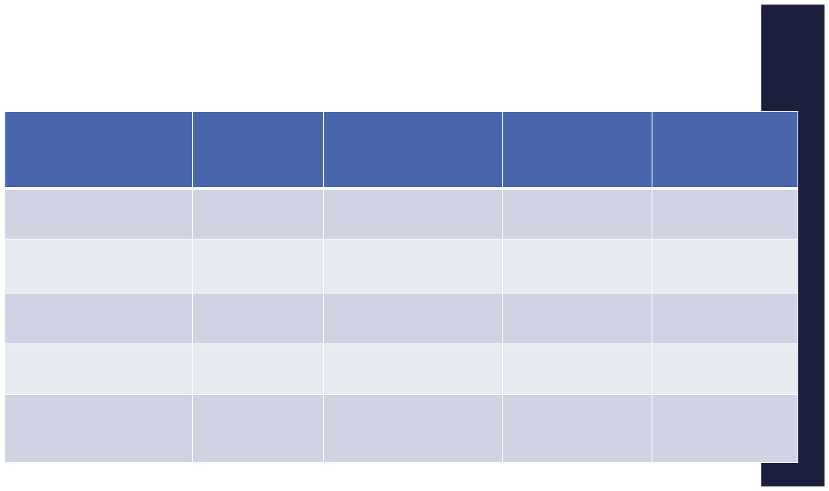
LITERATURE REVIEW
( MIN 10 REVIEW PAPERS)
Paper Title
Author & year
Methodology
Inference
Limitations
Attention-based NMT with
Artificial Pronunciation
for Nahuatl
Attention-based NMT with artificial
pronunciation for low-resource
language (Nahuatl)
Bello García et al.
Demonstrated viability of translating
endangered languages using
tailored NMT and TTS strategies
Limited corpora; specialized for
a single low-resource language
Google’s Neural Machine
Translation System
Transformer architecture with
self-attention, BPE tokenization,
end-to-end training
Revolutionized MT with
near-human performance
Requires high computational
resources; not suitable for
low-resource languages directly
Wu et al. (2016)
Neural MT by Jointly Learning
to Align and Translate
RNN with attention mechanism
for dynamic word alignment
Solved fixed-length bottleneck,
foundational to modern
NMT models
Pre-Transformer; less efficient
and slower compared to
newer architectures
Bahdanau et al. (2015)
MelNet: Frequency-Domain
Audio Generation
Autoregressive TTS using
frequency domain instead
of waveform
Improved TTS prosody and
long-range dependencies
Computationally complex;
not widely adopted
Vasquez & Lewis (2019)
Factorized WaveNet for
Voice Conversion with
Limited Data
Voice conversion with
parameter-efficient
WaveNet
Du et al. (2019)
Enabled speaker voice
change with minimal data
Quality may degrade with extreme voice variations

Slide 11
LITERATURE REVIEW
( MIN 10 REVIEW PAPERS)
Paper Title
Author & year
Methodology
Inference
Limitations
Lost in Translation: Analysis of Info Loss Between Polysynthetic & Fusional Languages
Mager et al. (2020)
Empirical BERT-style model
evaluation between complex
morphology languages
Highlighted how MT struggles with
morphological richness
(e.g., Tamil, Nahuatl)
Low effectiveness for agglutinative
languages without specialized
models
Improved MT accuracy for morphologically rich languages (e.g., Tamil, Turkish)
Attention Is All You Need
Vaswani et al. (2017)
Introduced Transformer
using multi-head
self-attention
Foundation for modern NMT (e.g., GPT, BERT); used in tools like mtranslate
High model complexity;
requires extensive
training data
Speaker-Dependent ASR for Low-Resource Languages (Huastec Náhuatl)
Developed speaker-dependent
acoustic models for ASR
in low-resource languages
Informs ASR tuning for
dialects like Tamil
Speaker-dependent
ASR limits scalability
Nolazco-Flores et al.
Hacia la Traducción Automática
de las Lenguas
Indígenas de México
Emphasized collaborative
corpus development and
translation for indigenous
languages
Highlighted ethical, cultural,
and linguistic considerations
for fair translations
Requires native input;
lacks standardized
evaluation protocols
Mager & Meza
Fine-Grained Attention
Mechanism for Neural Machine Translation
Word-splitting into
subword units with
fine-grained attention
Improved MT accuracy for
morphologically
rich languages
(e.g., Tamil, Turkish)
High training overhead; complexity in subword aggregation
Choi, Cho, Bengio (2017)

Slide 12
SUMMARY
This project explores the fundamental concepts and techniques in Natural Language Processing (NLP), focusing on how machines analyze, understand, and process human language. It covers essential tasks such as tokenization, part-of-speech tagging, named entity recognition, and basic text classification using tools like NLTK and spaCy. The scope includes working primarily with English text and applying foundational models like Bag-of-Words and TF-IDF. While advanced deep learning models and multilingual NLP are out of scope, the project lays the groundwork for understanding more complex language technologies.

Slide 13
PROPOSED SYSTEM AND
ITS METHODOLOGY
Proposed System:
Develops a real-time voice translation system that integrates speech recognition, language detection, machine translation, and text-to-speech technologies using Python-based libraries. The system aims to enhance cross-lingual communication by automatically detecting spoken input, translating it into the desired language, and vocalizing the output with adjustable speech speed.
Methodology:
1. Preprocessing – Capture and preprocess voice input using the speech_recognition library and convert it into text.
2. Language Detection – Identify the language of the input text using langdetect, with fallback mechanisms for reliability.
3. Translation Engine – Use mtranslate or Google Translate API to convert the input text into the target language.
4. Speech Synthesis – Convert translated text into speech using gTTS, and adjust playback speed with pydub.
5. User Interface – Develop a responsive interface using Streamlit to handle input, translation, and audio output.
6. Evaluation – Assess performance using translation accuracy, TTS quality, and latency across multiple target languages.
7. Analysis – Compare language-wise performance and highlight strengths/weaknesses in speech recognition and translation.

Slide 14
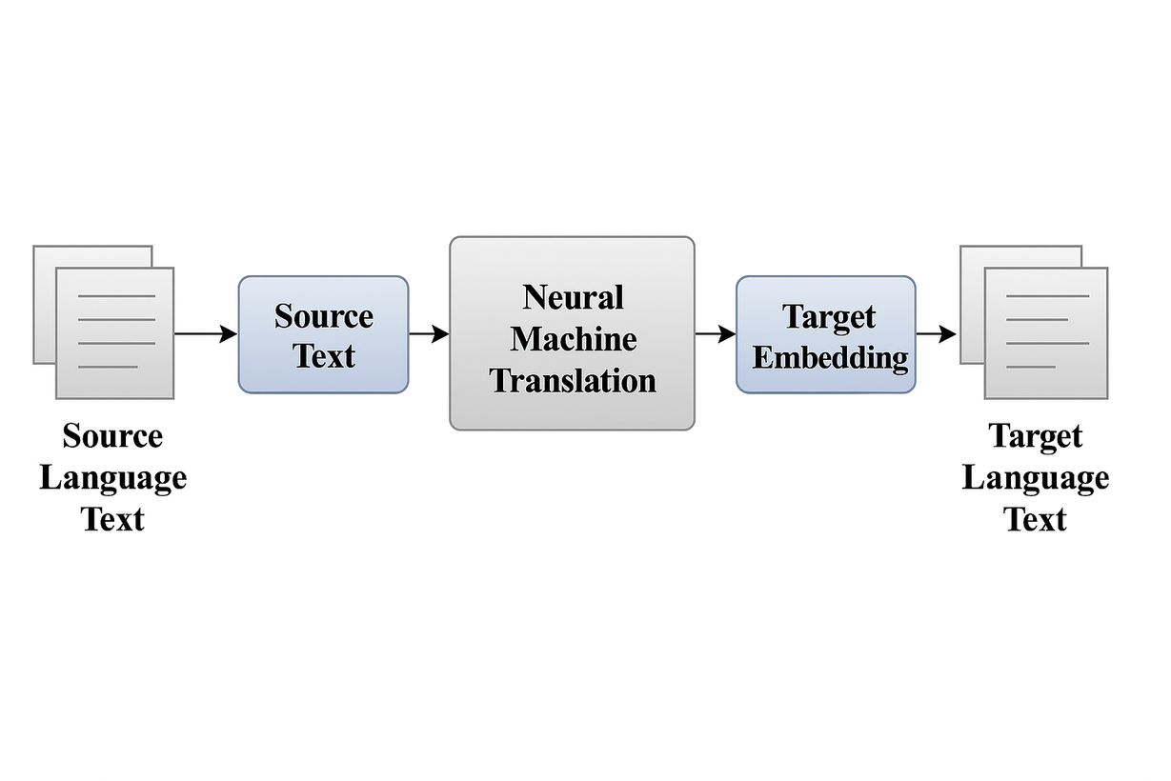
ARCHITECTURE DIAGRAM
AUDIO
INPUT
L
L
AUDIO
OUTPUT

Slide 15
LIST OF MODULES
LIST OF MODULES
Voice Input Processing Module
Language Detection Module
Translation Engine Module
Audio Synthesis Module
User Interface Module
System Utilities Module

Slide 16
MODULE DESCRIPTION
Voice Input Processing Module
The system begins with voice capture through microphone input, where the speech_recognition library records and converts spoken words into WAV-format audio.
Voice Input Detection Module
Transcribed text is analyzed by the langdetect component to identify the source language (e.g., detecting Tamil as "ta"). The module employs probabilistic language modeling, falling back to English if confidence thresholds are unmet.
Translation Engine Module
Leveraging the mtranslate library with Google Translate backend, this module converts source text to the user-selected target language (e.g., Tamil→English).

Slide 17
MODULE DESCRIPTION
Audio Synthesis Module
Translated text is vocalized using Google's Text-to-Speech (gTTS) with configurable speech rate. The pydub library then adjusts playback speed (0.5x-2x) without pitch distortion, generating MP3 streams compatible with web browsers.
User Interface Module
Built with Streamlit, this module provides interactive controls for language selection, recording triggers, and speed adjustment. It displays both translated text and audio player widgets, with session state persistence enabling seamless multi-step interactions.
System Utilities Module
Background services manage temporary file cleanup (WAV/MP3) and error recovery, including API rate limit handling and fallback translations. Logging tracks usage metrics and failure modes for debugging, while environment variables secure API credentials.

Slide 18
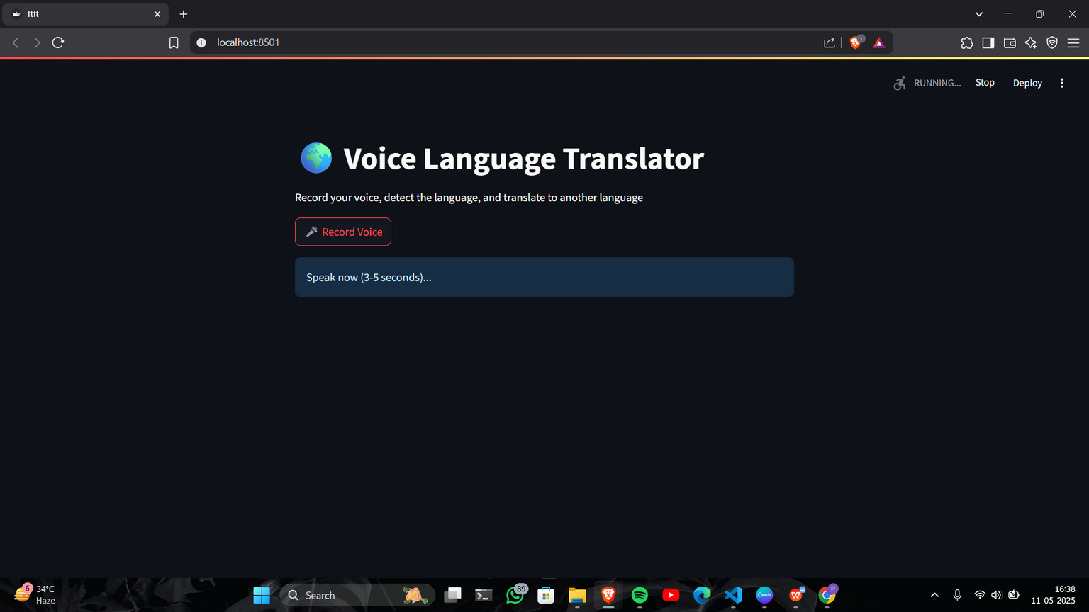
OUTPUT AND SCREENSHOTS

Slide 19
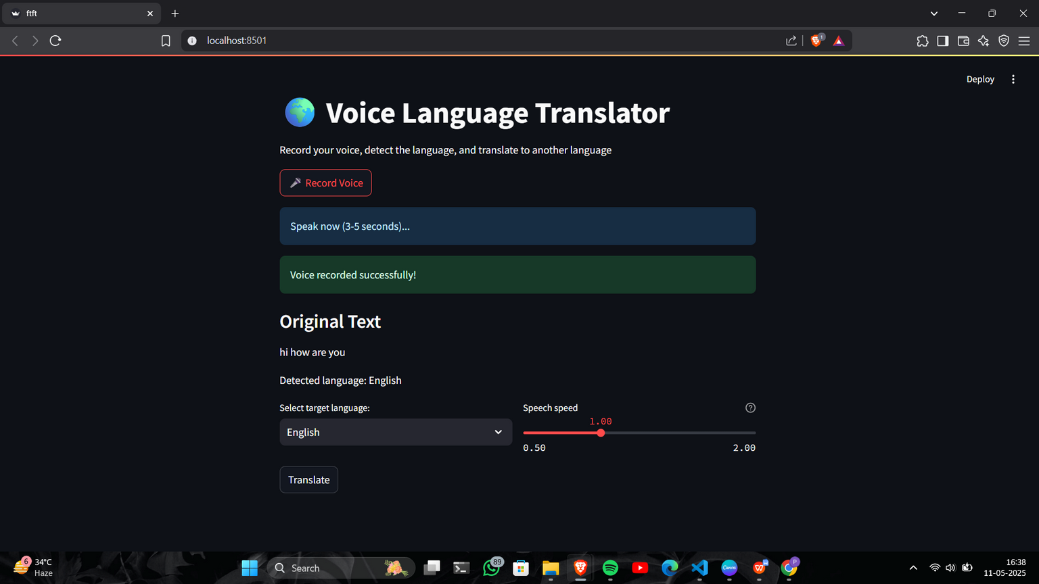
OUTPUT AND SCREENSHOTS

Slide 20
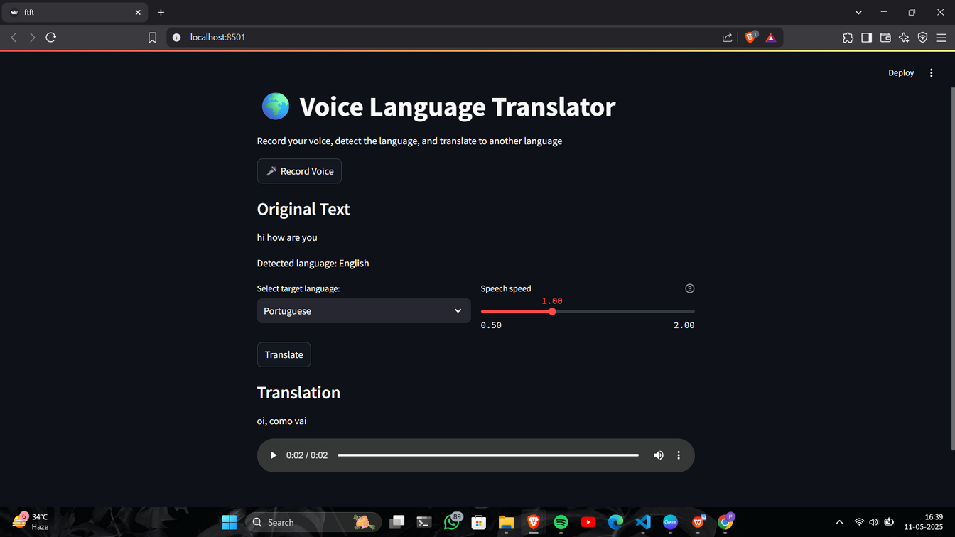
OUTPUT AND SCREENSHOTS

Slide 21
COMPARITIVE ANALYSIS
Voice language translation systems combine speech recognition, machine translation, and text-to-speech to convert spoken input from one language to another. Traditional modular systems offer flexibility and accurate components but may suffer from error propagation across stages. In contrast, newer end-to-end models like Meta’s SeamlessM4T reduce intermediate errors and handle context better, though they require more data and computing power. Neural machine translation now dominates the field, offering more natural and fluent translations. While modular systems remain practical, end-to-end approaches show greater potential for real-time, multilingual applications.

Slide 22
CONCLUSION
In conclusion, voice language translation using machine translation has evolved from modular systems to more efficient end-to-end models. While both approaches have their strengths, end-to-end systems offer better accuracy and contextual understanding, making them ideal for real-time and multilingual communication. As technology advances, these systems are expected to become faster, more accurate, and widely accessible.

Slide 23
REFERENCES
[1] Vaswani, A., et al. (2017). Attention is All You Need. Advances in Neural Information Processing Systems (NeurIPS).
[2] Chan, W., et al. (2016). Listen, Attend and Spell. IEEE International Conference on Acoustics, Speech and Signal Processing (ICASSP).
[3] Jia, Y., et al. (2019). Direct speech-to-speech translation with a sequence-to-sequence model. Interspeech.
[4] Tiedemann, J., & Thottingal, S. (2020). OPUS-MT – Building open translation services for the World. EAMT Conference.
[5] Zhang, Y., et al. (2023). SeamlessM4T: Massively Multilingual & Multimodal Machine Translation. Meta AI Research.

Slide 24
REFERENCES
[6] Radford, A., et al. (2023). Whisper: Robust Speech Recognition via Large-Scale Weak Supervision. OpenAI.
[7] Bahdanau, D., et al. (2014). Neural Machine Translation by Jointly Learning to Align and Translate. arXiv:1409.0473.
[8] Huang, J.-T., et al. (2013). Deep Learning for Speech Recognition. IEEE Signal Processing Magazine.
[9] Google Cloud. (2024). Cloud Speech-to-Text Documentation. https://cloud.google.com/speech-to-text
[10] Wu, Y., et al. (2016). Google’s Neural Machine Translation System: Bridging the Gap between Human and Machine Translation. arXiv:1609.08144.

